Slide 1
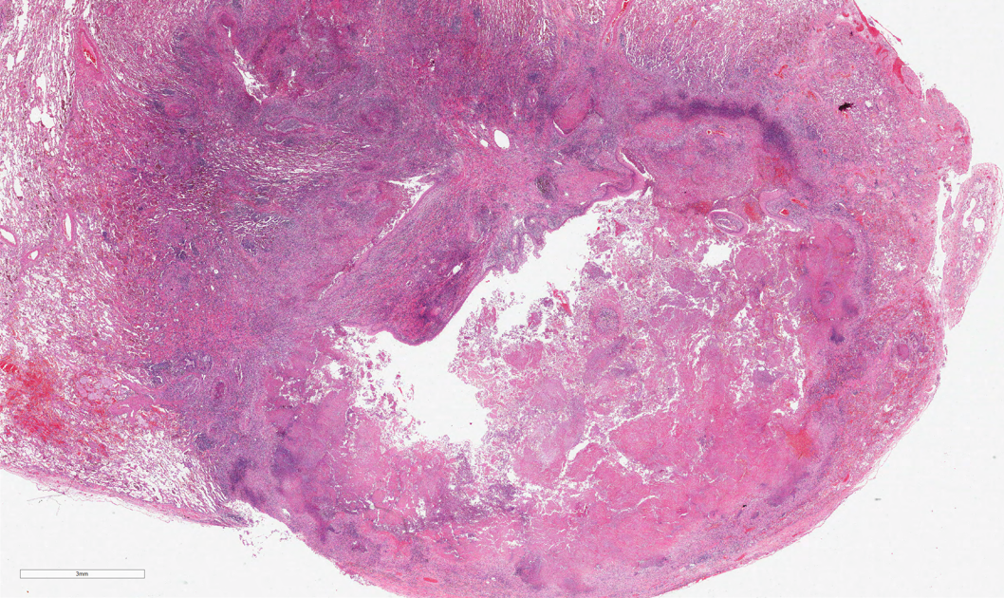
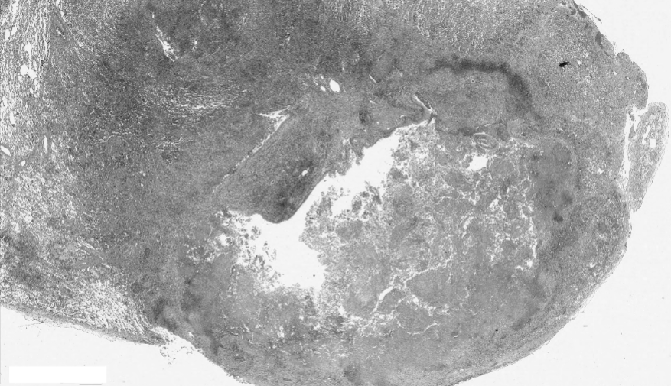
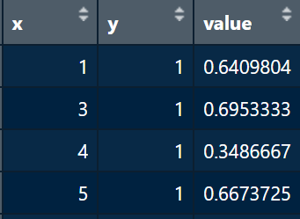
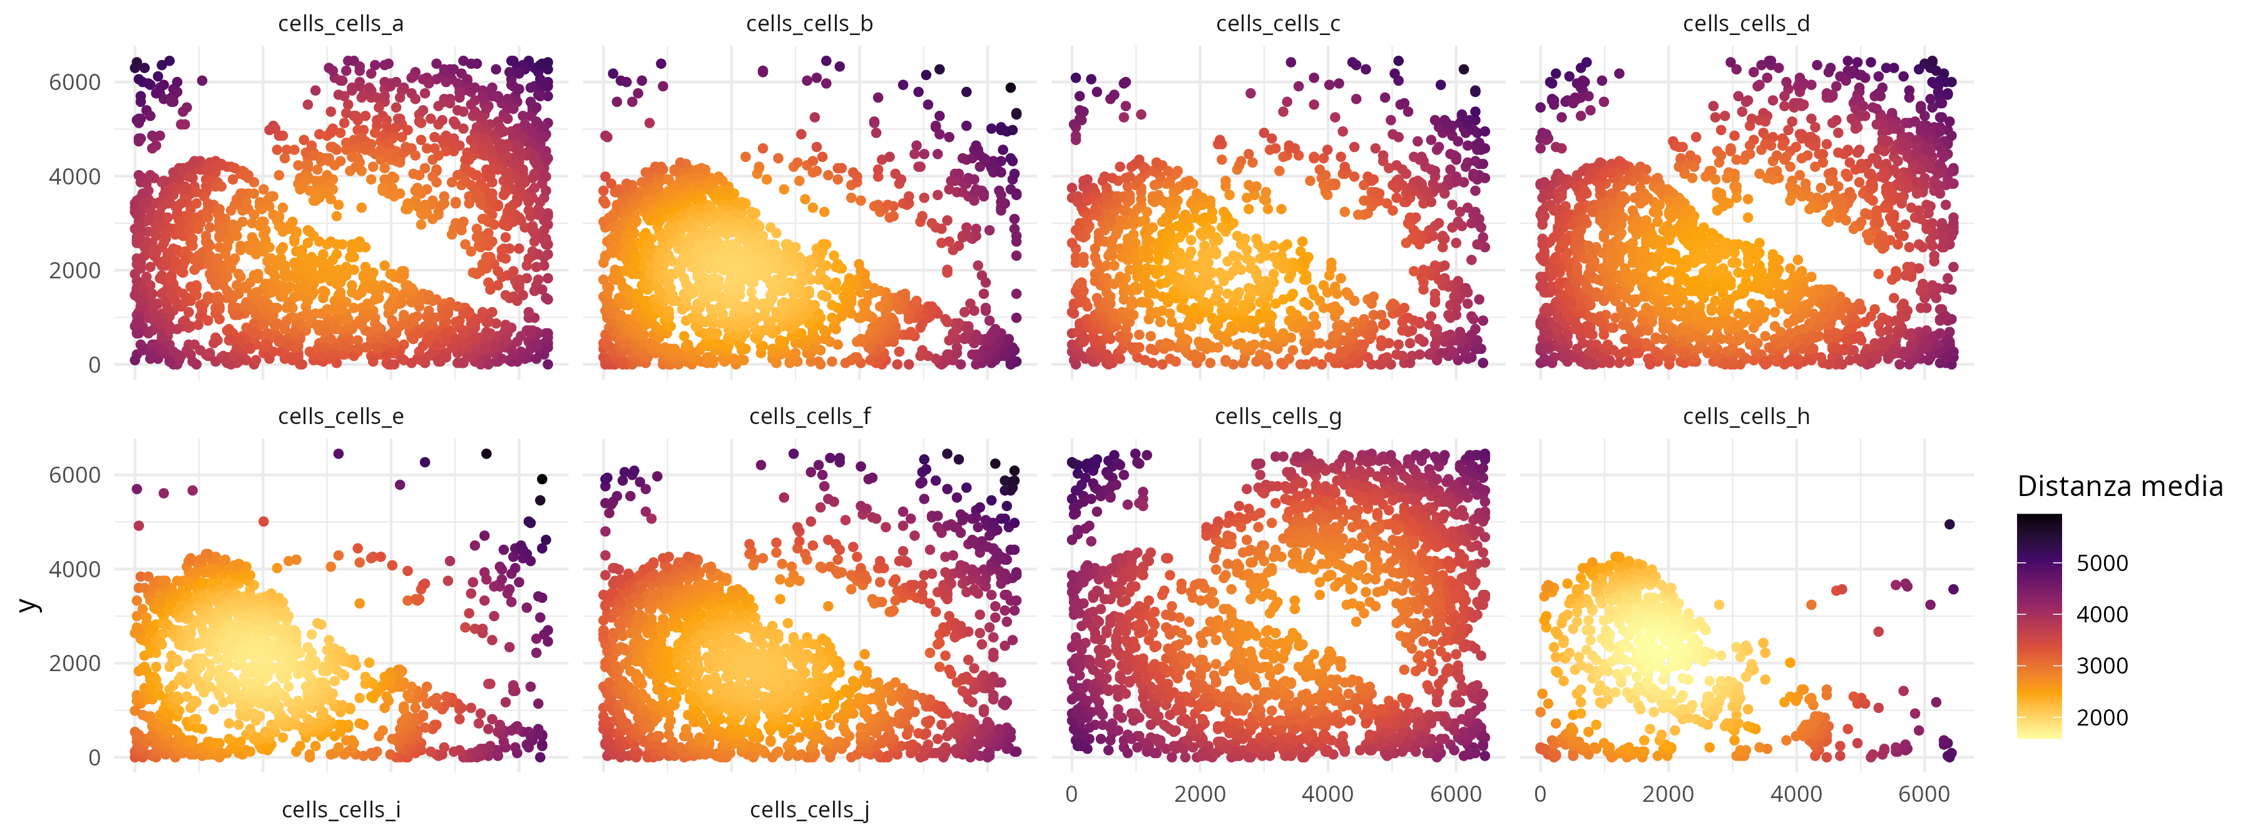





spatialBenchR: a Simulation framework for
spatial single-cell RNA-sequencing data
Daniele Sabbatini^{1,2}, Pierangela Palmerini^{1,3}, Giorgia Stoppa¹, Dolores Cattelan¹, Annibale Biggeri¹, Dario Gregori¹ and Luca Vedovelli¹
¹Department of Cardiac, Thoracic, Vascular Sciences and Public Health, University of Padua, Italy
²Department of Neurosciences, University of Padua, Italy
³Veneto Institute of Oncology-IRCCS, Padua, Italy
Introduction
Developing robust analytical methods for single-cell spatial transcriptomics requires rigorous evaluations against data with a known ground truth, yet generating such gold-standard data experimentally is prohibitively expensive, time-consuming, and technically challenging. Computational simulations provide a compelling alternative by producing synthetic datasets with fully controllable properties. However, many existing simulators rely on oversimplified statistical assumptions, unrealistic tissue geometries, homogeneous technical artifacts, and artificially sharp boundaries. Our framework overcomes these shortcomings with advanced statistical models and biologically informed spatial patterns, recreating realistic noise, gradual transitions between cell types, and enabling systematic benchmarking under near–in vivo conditions.
1. Configuration parameters
2. Image processing and grid creation
The framework operates through a flexible parameterization system allowing both full control on custom configurations but also giving
pre-defined difficulty levels for a quick start:
Custom Parameter Control System:
- Spatial organization: Users precisely control spatial noise intensity (0.5-2.0 scale), correlation range (15-100μm), and pattern types (continuous gradients, multi-scale hierarchies, or non-stationary patches with region-specific properties)
- Cell type definition: Configurable marker gene counts (3-15 per type), expression fold-changes (+0.8 to +3.0 log-scale), and inter-type overlap percentages (0-50%) to simulate varying degrees of cell type distinctiveness
- Technical artifact modeling: Independent control of dropout rates (5-70%), ambient RNA contamination (0-15%), library size variation (CV 0.1-0.8), and gene-specific biases reflecting real platform characteristics
- Biological complexity modules: Toggle advanced features including ligand-receptor interactions (10-50 pairs), temporal dynamics with pseudotime trajectories, alternative splicing regulation (20-60% of genes), anisotropic patterns along tissue structures, and 3D microenvironment effects
Pre-defined Difficulty Tiers:
- Easy Level: Creates ideal analytical conditions with 10 strong marker genes per cell type (+2.0 log-fold), zero overlap between types, minimal spatial noise (intensity 0.5, range 50μm), low dropout (5-15%), and high dispersion parameters (3.0-1.5 range) for clear cluster separation
- Medium Level: Introduces realistic complexity with 7 moderate markers (+1.2 log-fold), 20% inter-type overlap, substantial spatial correlation (intensity 1.0, range 30μm), moderate dropout (15-30%), and intermediate dispersion (2.0-1.0) reflecting high-quality experimental data
- Hard Level: Generates extreme analytical challenges with only 5 weak markers (+0.8 log-fold), 40% overlap creating ambiguous boundaries, strong spatial noise (intensity 1.5, range 15μm), severe dropout (30-70%), low dispersion (1.5-0.8), and additional random noise (SD 0.4) mimicking difficult real-world datasets
Technology-Specific Grid Configuration:
- Visium HD simulation: Implements 2μm×2μm adjacent spots with no inter-spot gaps, matching the ultra-high-resolution geometry of Visium HD technology for subcellular pattern analysis
- Standard Visium: Uses 55μm spots with 100μm center-to-center spacing, replicating the geometry of conventional Visium arrays for tissue-level analysis
- Custom grid systems: Flexible grid dimensions (1-20μm resolution), spacing patterns, and capture area geometries to model emerging spatial technologies or experimental variations
- Fixed vs. adaptive grids: Option for standardized slide dimensions (6.5×6.5mm) or tissue-adaptive grids that conform to irregular tissue shapes while maintaining regular sampling patterns
human granuloma
H&E
human granuloma
greyscale
Image preprocessing: Loads RGB tissue images, applies Gaussian smoothing and contrast enhancement to optimize segmentation quality
Tissue segmentation: Uses Otsu thresholding to automatically separate tissue regions from background, followed by morphological operations to refine boundaries
Grid overlay: Creates regular sampling grids matching specific technologies - Visium HD uses 2μm×2μm adjacent spots, standard Visium uses 55μm spots with defined spacing
Deterministic mapping: Each grid position is assigned to tissue regions through nearest-neighbor mapping, ensuring complete coverage and reproducible cell-to-location assignments
3. Clustering and sampling
K-means++ spatial clustering: Applies improved k-means initialization to tissue coordinates, creating spatially coherent regions that reflect realistic tissue architecture
Boundary gradient modeling: Implements soft boundaries between cell types using distance-based gradients with configurable transition widths (1-10 grid units) and exponential decay functions
Hybrid cell generation: Creates intermediate-phenotype cells at cluster boundaries by mixing expression profiles from adjacent cell types with controllable intensity (0.2-0.7)
Cell type mapping: Assigns each spatial cluster to specific cell types while maintaining spatial coherence and biological plausibility
4. Expression matrix generation
The core expression simulation integrates multiple biological and technical layers:
Baseline expression: Generates cell type-specific expression using negative binomial distributions with realistic mean-variance relationships matching empirical data
Spatial correlation: Applies Gaussian Random Fields with exponential covariance (range 15-100μm) to create continuous spatial patterns, or multi-scale models combining macro-domains (80μm range) with micro-environments (15μm range)
Advanced biological modules:
- Ligand-receptor interactions using exponential diffusion models (signaling distance 20-50μm)
- Temporal dynamics with pseudotime gradients and RNA velocity simulation
- Alternative splicing with spatial regulation patterns
- Anisotropic patterns following directional tissue structures
- Technical artifact modeling: Expression-dependent dropout using logistic curves, ambient RNA contamination with spatial diffusion, spatially-varying dispersion (higher at tissue edges), and gene-specific technical biases
Matrix assembly: Combines all effects multiplicatively or additively to generate the final expression matrix with preserved statistical properties
Results
Advantages of the proposed framework
1
2
Complete simulation control: Enable systematic evaluation of analytical methods across controlled
parameter ranges from simple to extremely challenging datasets
Realistic technical artifacts: Faithful reproduction of platform-specific biases including ambient RNA
contamination, spatial dropout patterns, and library size effects observed in real experiments
Modular biological complexity: Independent control over ligand-receptor signaling, developmental trajectories, alternative splicing, and tissue architecture features
Grid-based precision: Deterministic mapping between tissue images and measurement coordinates enables exact ground truth validation for spatial analysis algorithms
Systematic validation confirms the framework accurately reproduces key statistical properties of real
spatial transcriptomics data:
Expression distributions: Generated data matches empirical mean-variance relationships from real datasets, with proper overdispersion (variance > mean) for 90% of genes and sub-Poisson behavior for constitutive genes
Spatial autocorrelation: Marker genes exhibit expected spatial clustering patterns with Moran’s I statistics comparable to real tissue data
Dropout modeling: Expression-dependent dropout follows realistic logistic relationships where low-expression genes show 30-70% dropout while highly expressed genes show <10% dropout
Grid-based high-resolution simulation
The framework successfully models high-resolution technologies like Visium HD:
Ultra-high resolution: Generates coherent patterns at 2μm resolution with >50,000 spots per tissue
section while maintaining computational efficiency
Spatial pattern preservation: Complex tissue architectures (vascular networks, epithelial structures) are accurately captured at microscopic scales
Technology comparison: Direct comparison between standard and HD simulations demonstrates how resolution
affects pattern detection and analytical method performance
Conclusions
Repo & Contacts
This framework enables comprehensive benchmarking of spatial transcriptomics methods by generating data with controlled biological complexity and realistic technical challenges. The modular architecture facilitates systematic evaluation of analytical approaches while the parameterizable difficulty system supports both method development and educational applications. The framework will be available as an open-source R package with comprehensive validation tools.
daniele.sabbatini@ubep.unipd.it
luca.vedovelli@ubep.unipd.it

